Slide 1
CAPSTONE
PROJECT
Aviation Data Analysis using Apache Hive
COMPREHENSIVE (Assessment)

Slide 2
Team Members Details
S.No | Name | Roll No | Email | Phone No
1 | Tavva GNRSN Prudhvith (C5) | 142 | tavvag.narasimha@st.niituniversity.in | 7989846205
2 | Pisupati VNSSK Chaitanya (C4) | 085 | Pisupativ.chaitanya@st.niituniversity.in | 9660818556
3 | CVN Sai Koushik (C4) | 024 | Chimakurthiv.k@st.niituniversity.in | 9929628697
4 | Kattekola Vaishnavi (C4) | 270 | Kattekola.vaishnavi@st.niituniversity.in | 9849944301
5 | Batchu Naga Mahitha (C4) | 019 | BatchuN.Mahitha@st.niituniversity.in | 7023908759

Slide 3
Project Description
To perform aviation data analysis for gaining some insights on the world’s Airline data using Apache Hive.
The visualization of the data shows some outputs that exist between flight diversions and flight distance, flight cancellation and flight distance.
The main purpose of the project is to explore the data sets by analyzing with different tools and technologies to give the solutions for different aviation problems.

Slide 4
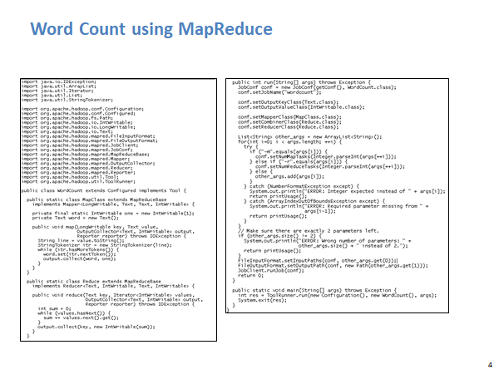

Slide 5
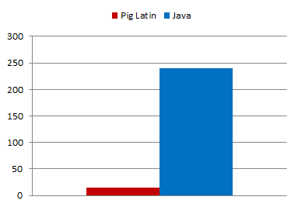
Word Count Using Pig
lines = LOAD '/user/hadoop/HDFS_File.txt' AS (line:chararray);
words = FOREACH lines GENERATE FLATTEN(TOKENIZE(line)) as word;
grouped = GROUP words BY word;
wordcount = FOREACH grouped GENERATE group, COUNT(words);
DUMP wordcount;

Slide 6
Problem Statement
Find out the top 5 most visited destinations.
Which month has seen the most number of cancellations due to bad weather?
Top ten origins with the highest Average departure delay.
Which route (origin & destination) has seen the maximum diversion?

Slide 7
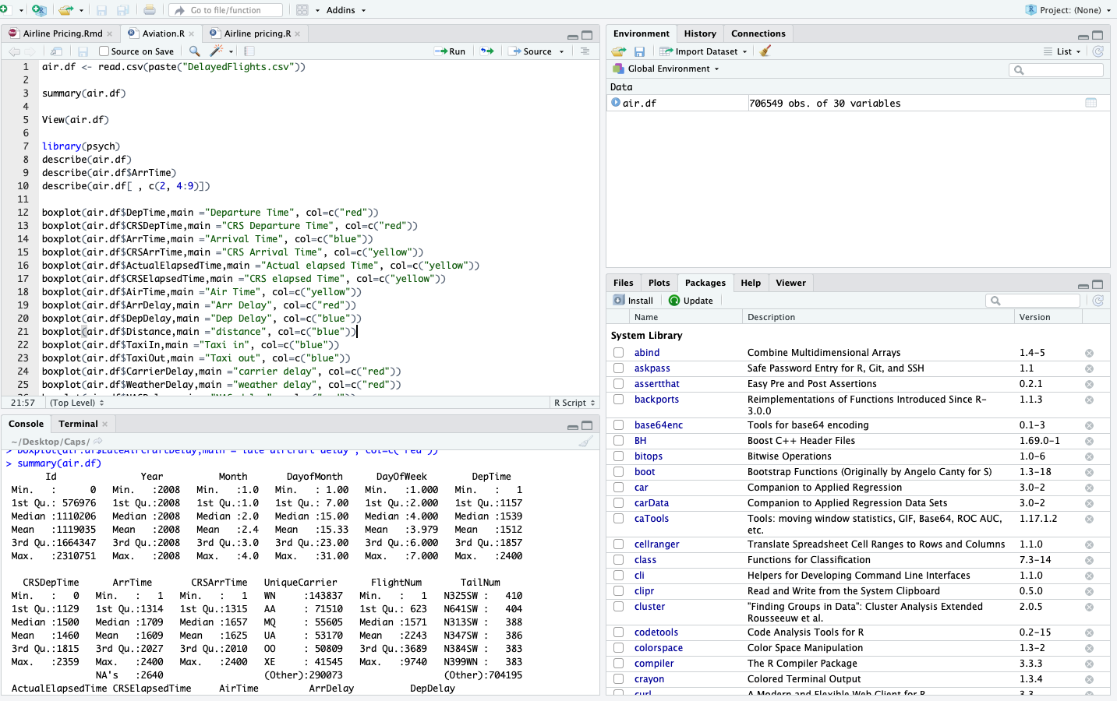

Slide 8
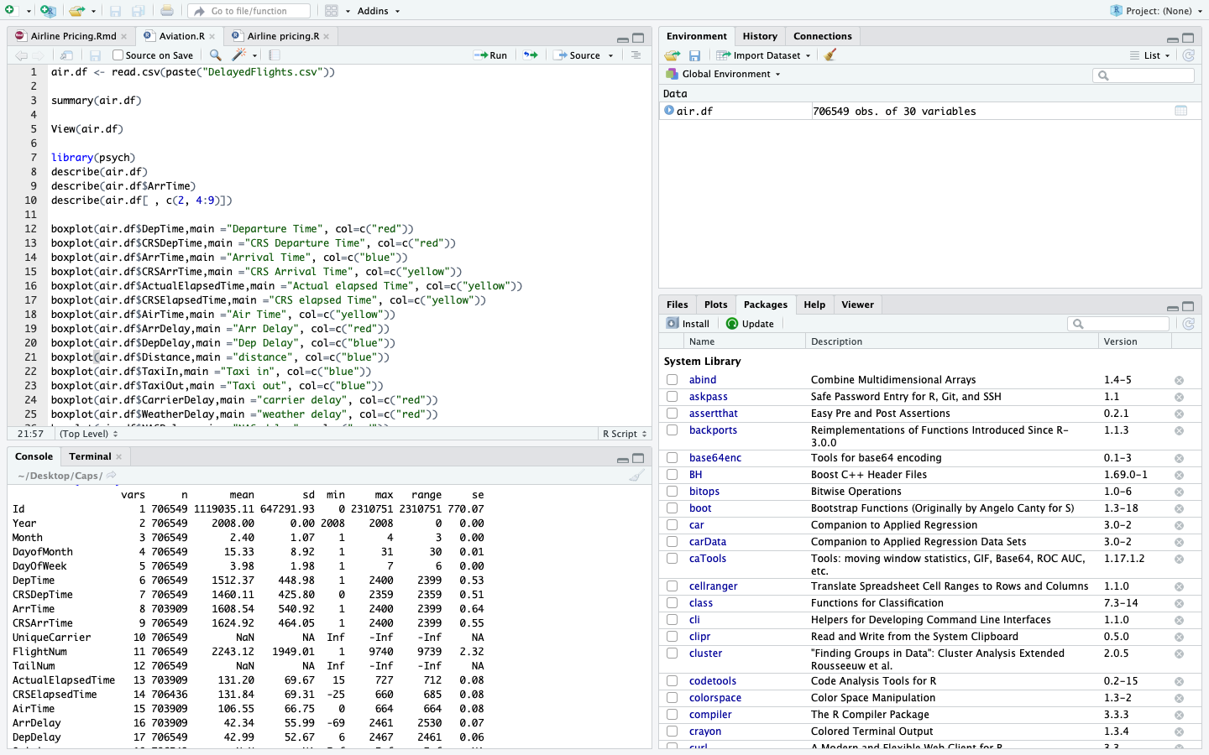

Slide 9
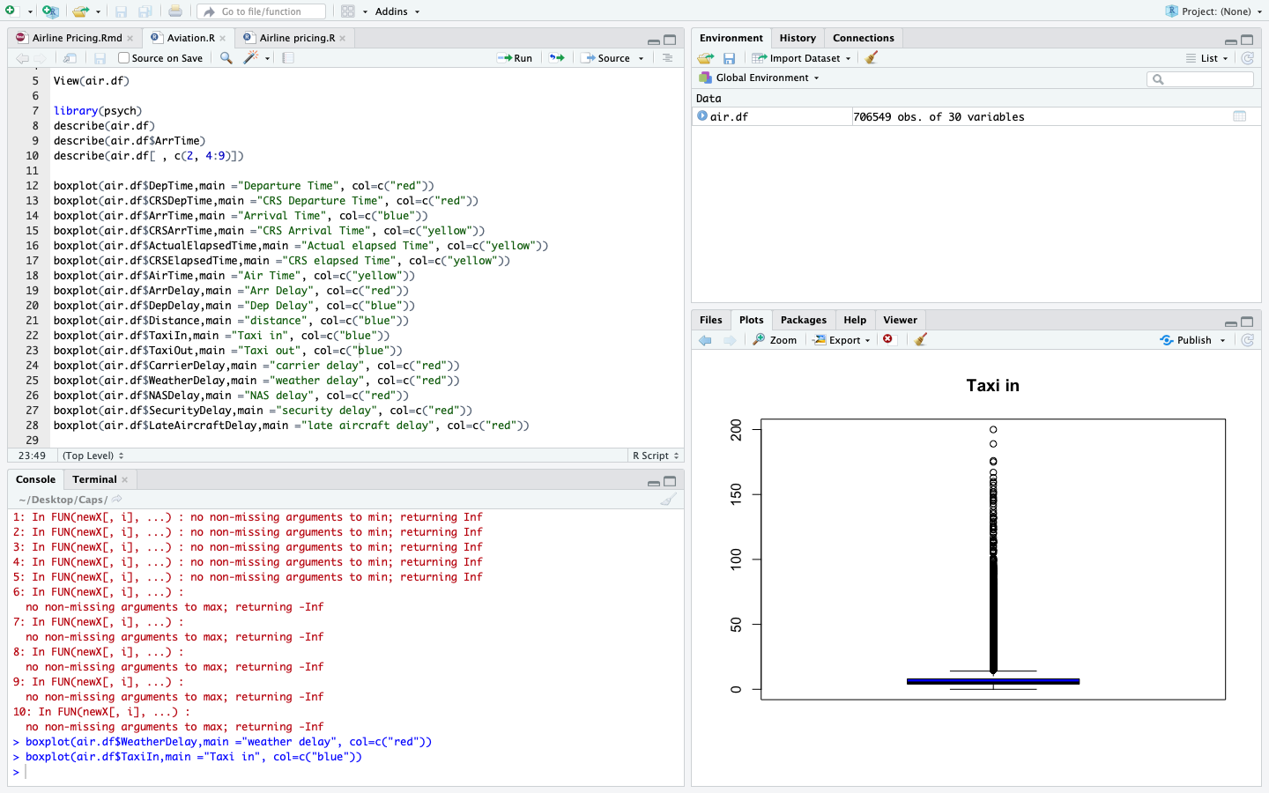

Slide 10
Problem Statement - 1
hive> Load Data inpath '/tmp/DelayedFlights.csv' INTO Table aviation;
hive> Select Dest,count(Dest) as VistedCount from aviation group by Dest order by VistedCount desc limit 5;
OUTPUT
ORD 108984
ATL 106898
DFW 70657
DEN 63003
LAX 59969

Slide 11
Problem Statement - 2
hive> select month,count(cancelled) as FlightsCancelled from aviation where Cancelled=1 AND CancellationCode='B' group by month order by FlightsCancelled desc limit 1;
OUTPUT
12 250

Slide 12
Problem Statement - 3
hive> select origin, AVG(depdelay)from aviation where distance > 2000 group by origin desc limit 10;
output
15.44 EWR
12.43 IAD
11.93 BOS
11.54 ANC
11.12 BWI
11.04 PIT
9.45 MCO
8.20 SAN
7.32 SLC
5.35 SJC

Slide 13
Problem Statement - 4
hive> select origin,dest,count(diversion) as FlightsCancelled from aviation where diversion = 1 group by origin,dest order by FlightsCancelled desc limit 10;
OUTPUT
ORD LGA 39
DAL HOU 35
DFW LGA 33
ATL LGA 32
MTA LGA 31
SLC SUN 31
ORD SNA 30
BUR JFK 29
HRL HOU 28
BUR DFW 25

Slide 14


Slide 15
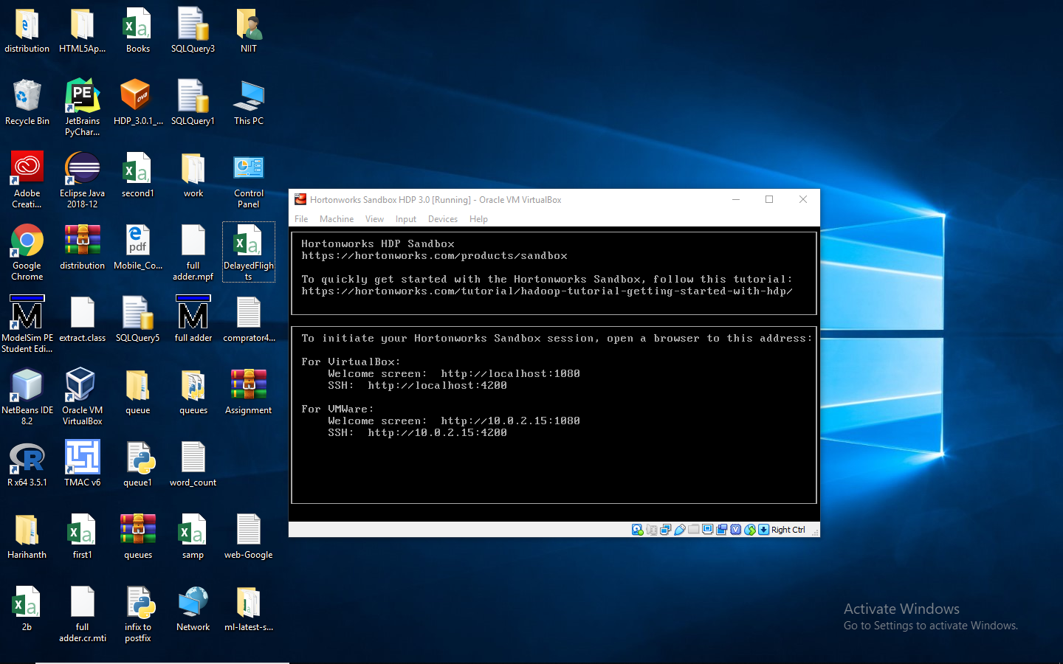

Slide 16


Slide 17


Slide 18
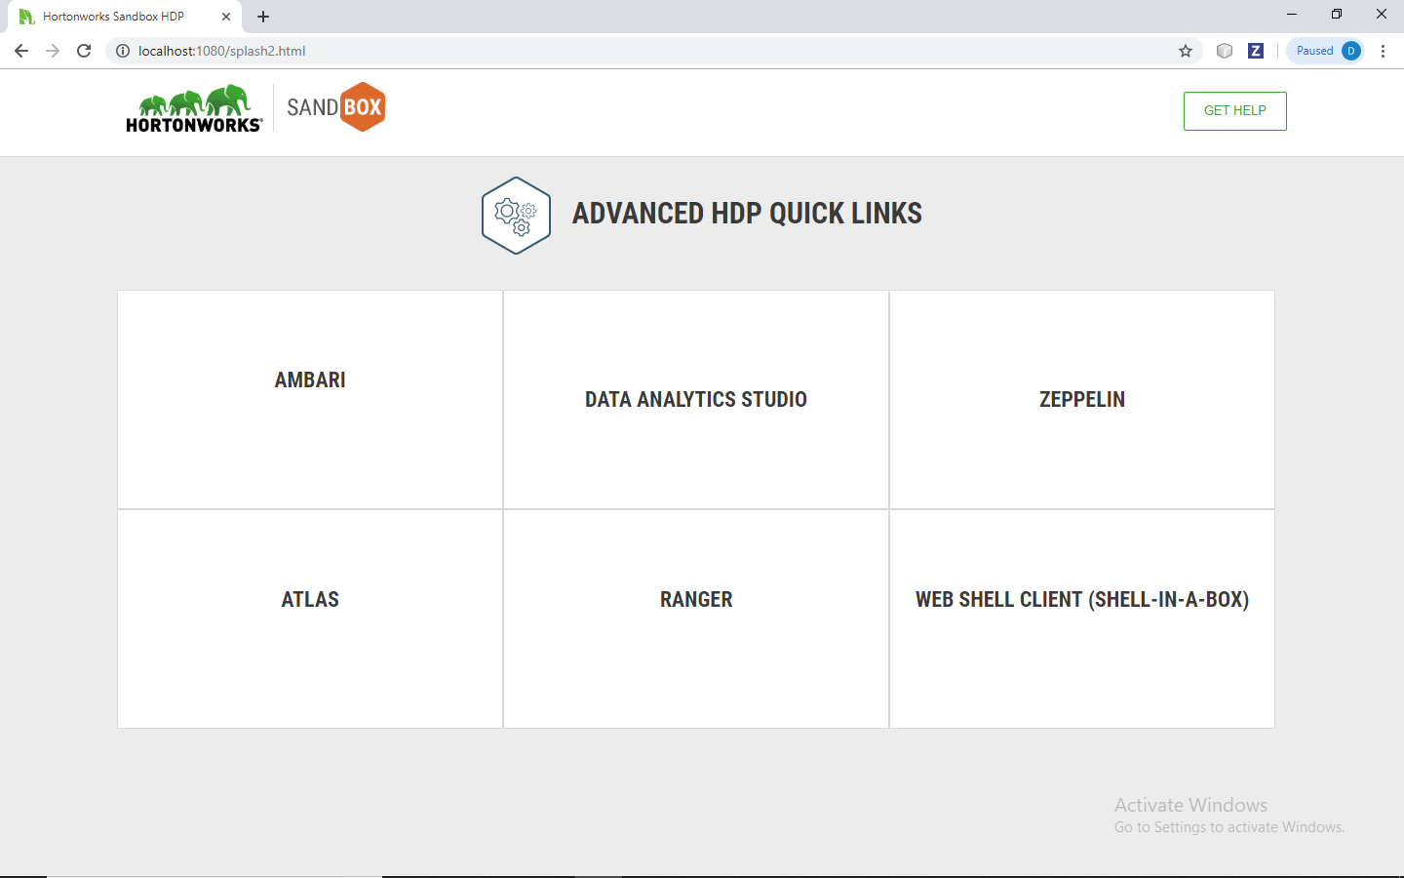

Slide 19
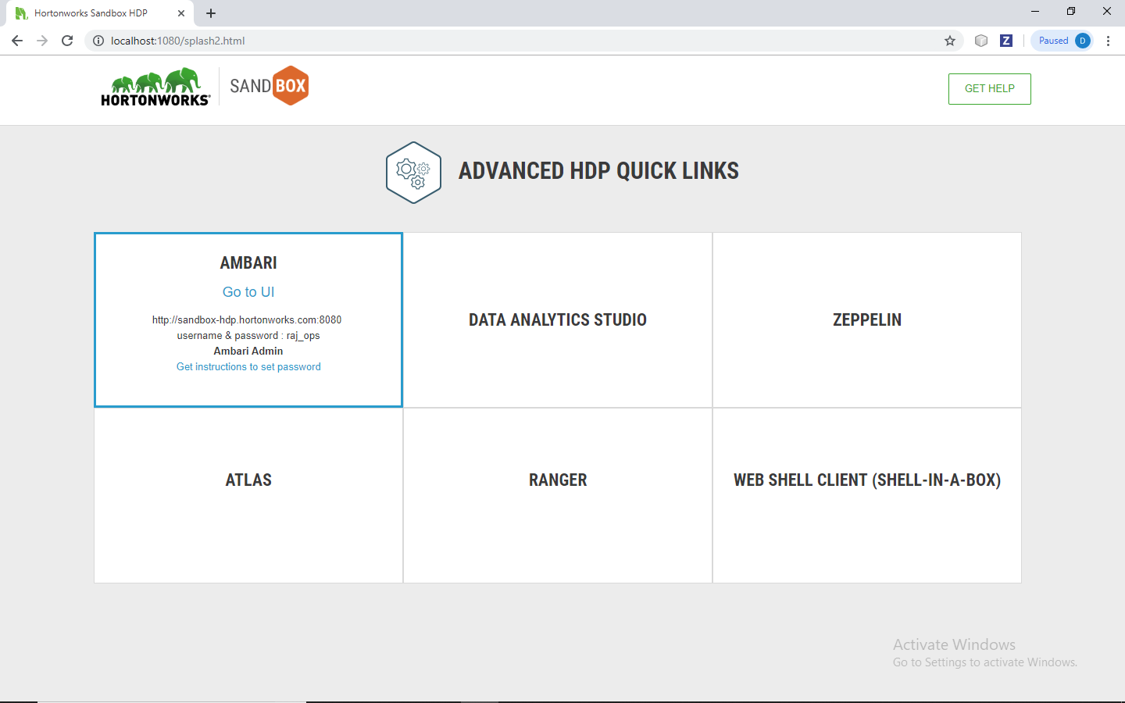

Slide 20
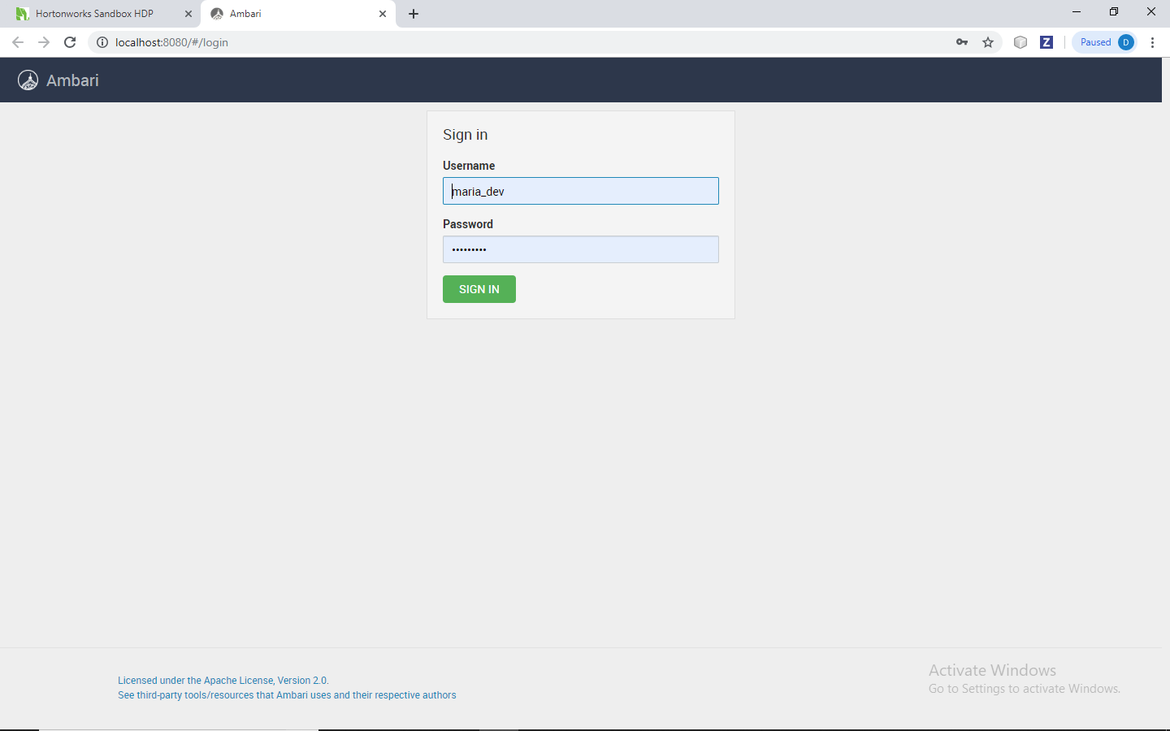

Slide 21
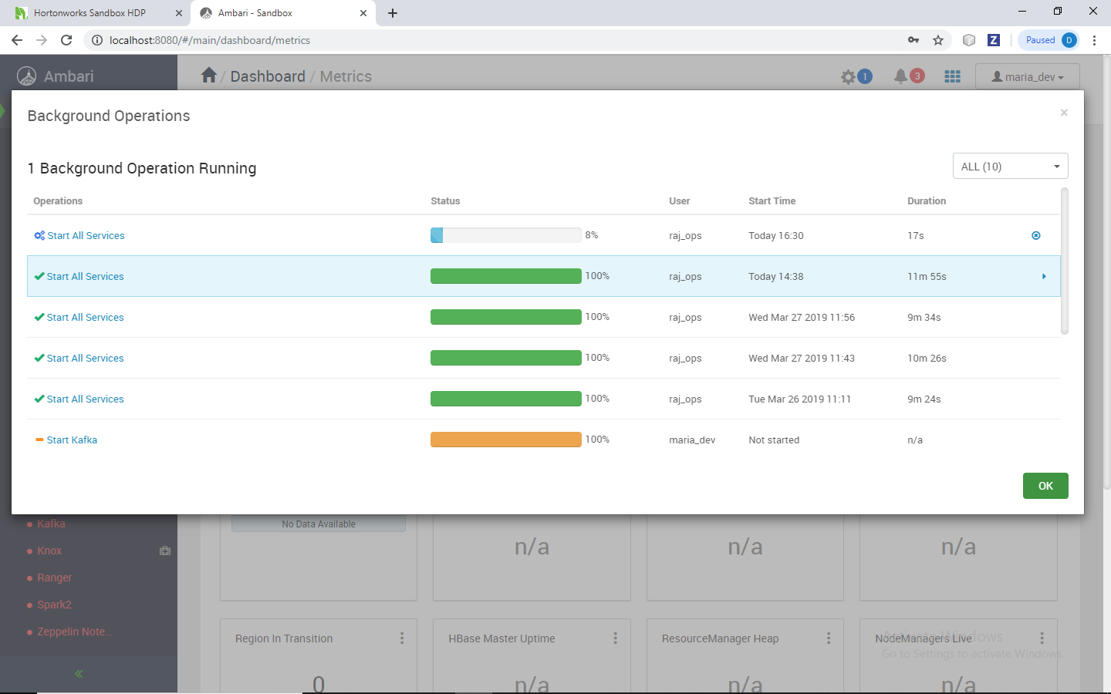

Slide 22
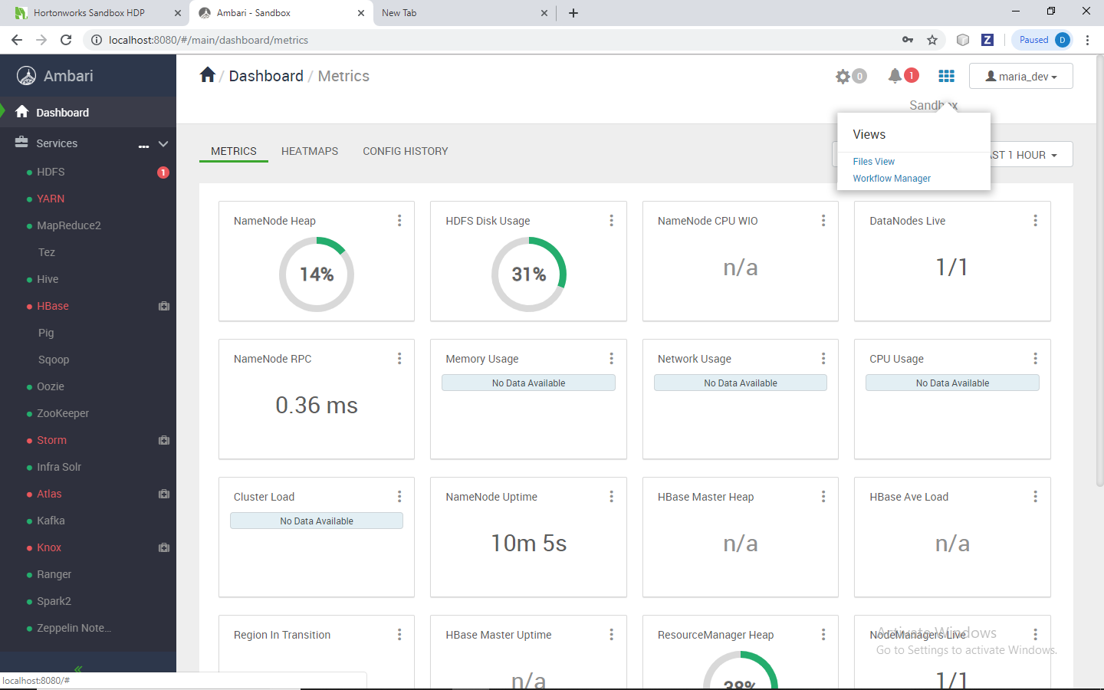

Slide 23
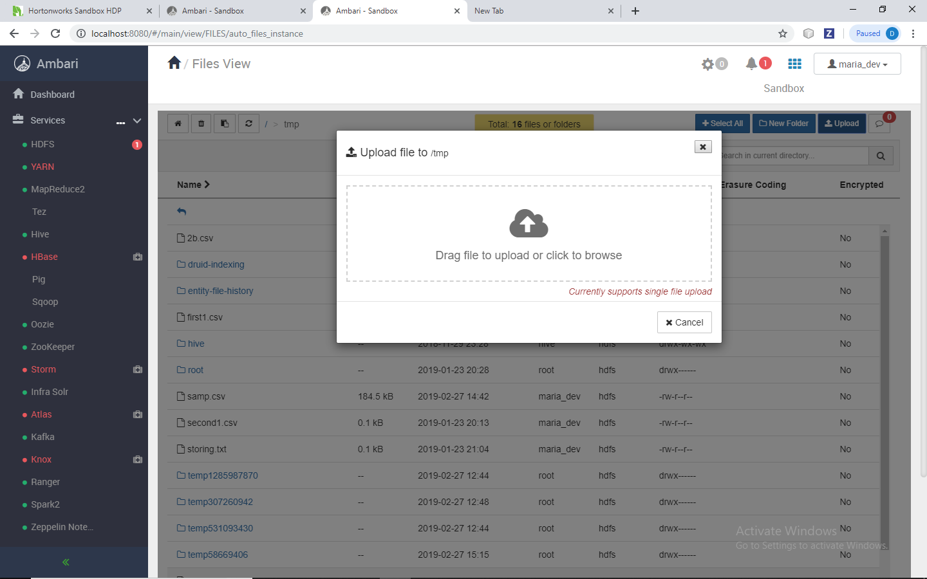

Slide 24
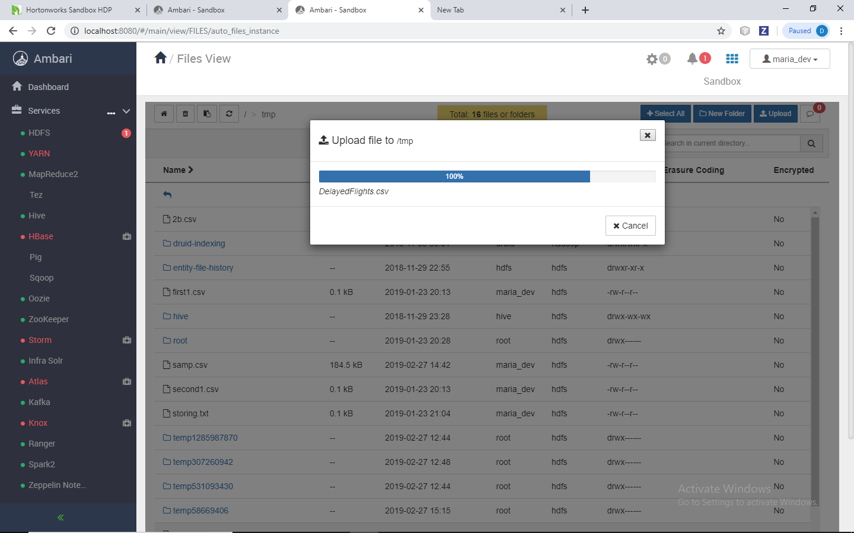

Slide 25
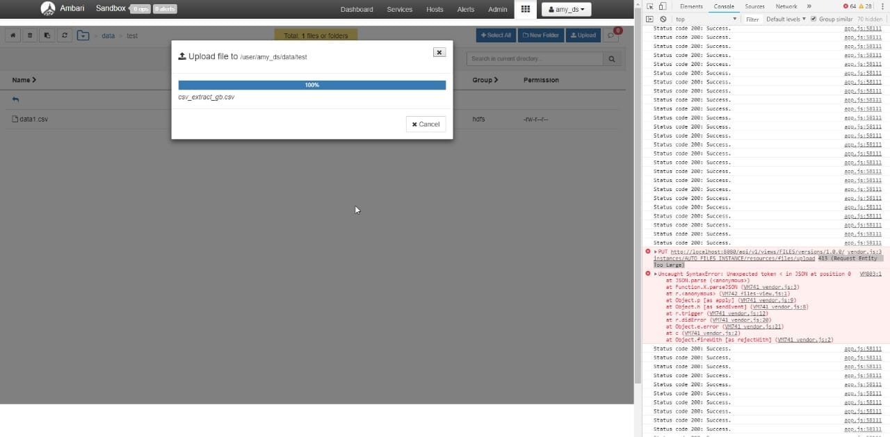

Slide 26
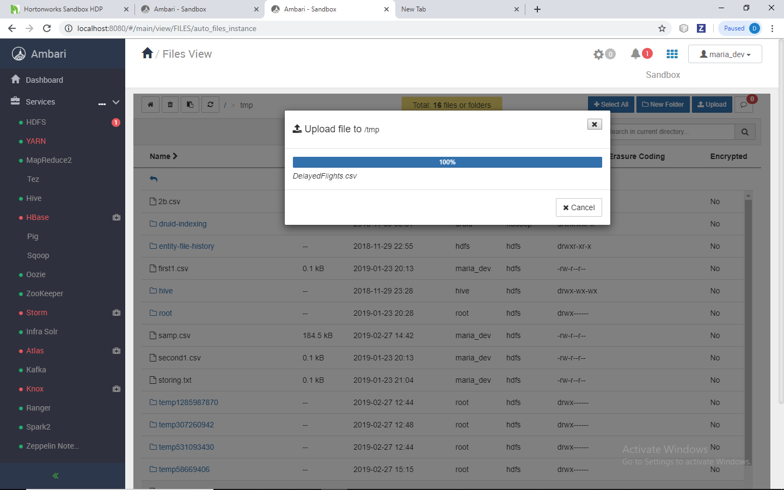

Slide 27
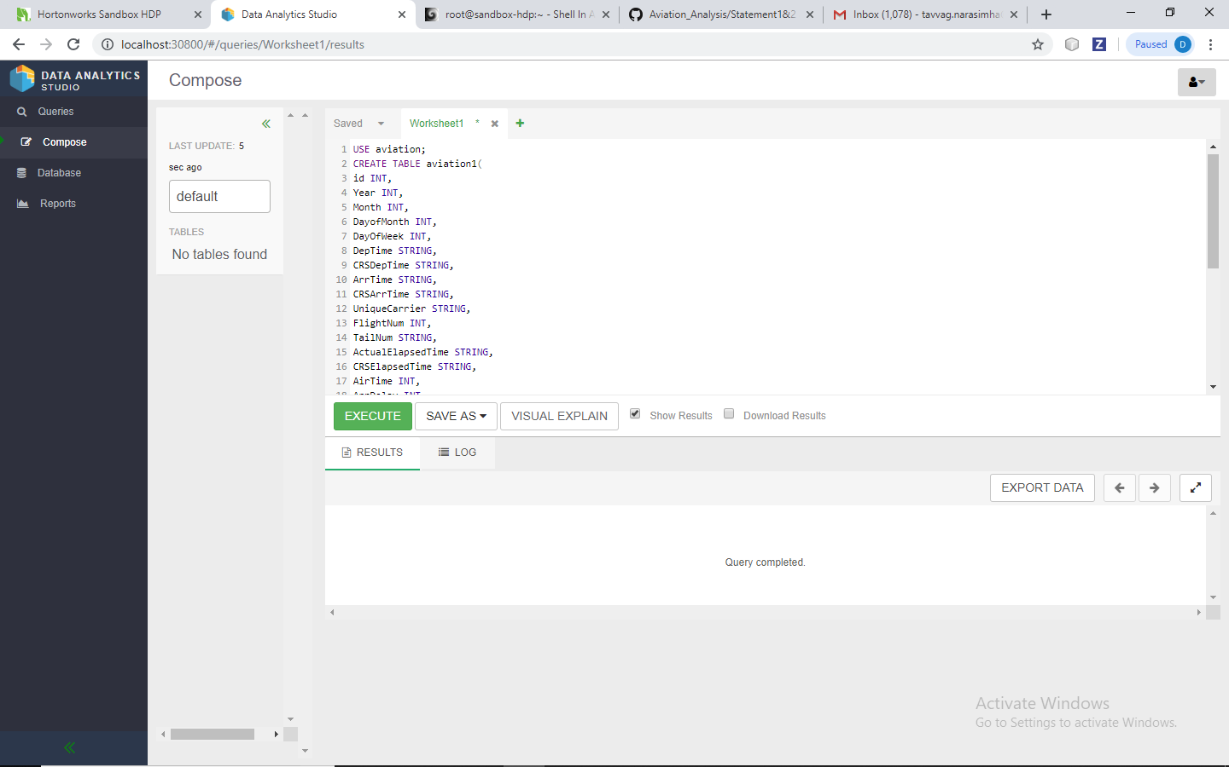

Slide 28
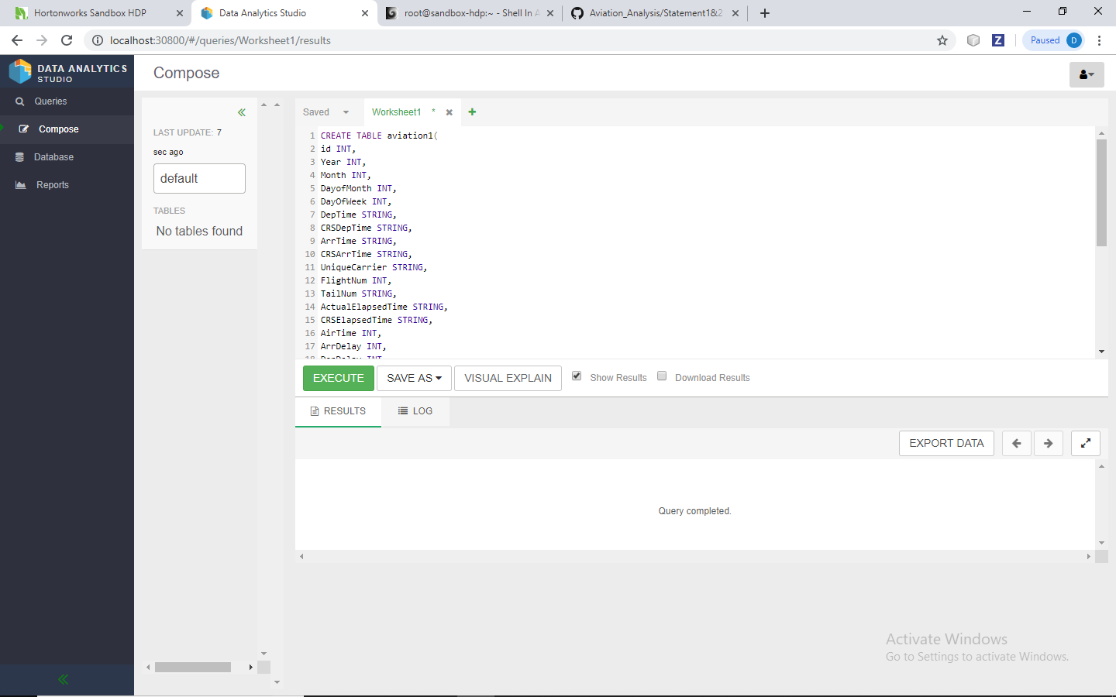

Slide 29
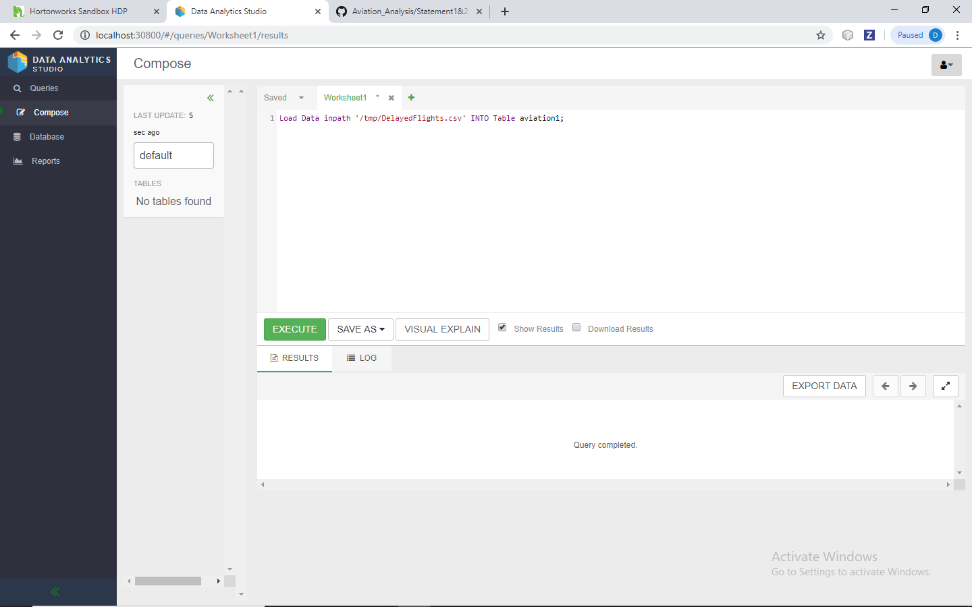

Slide 30
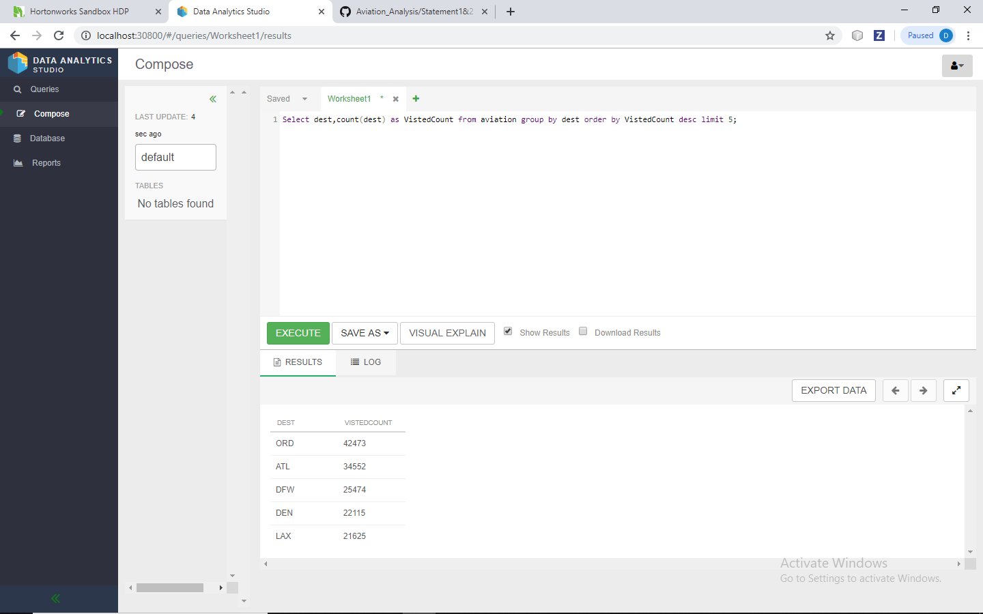

Slide 31
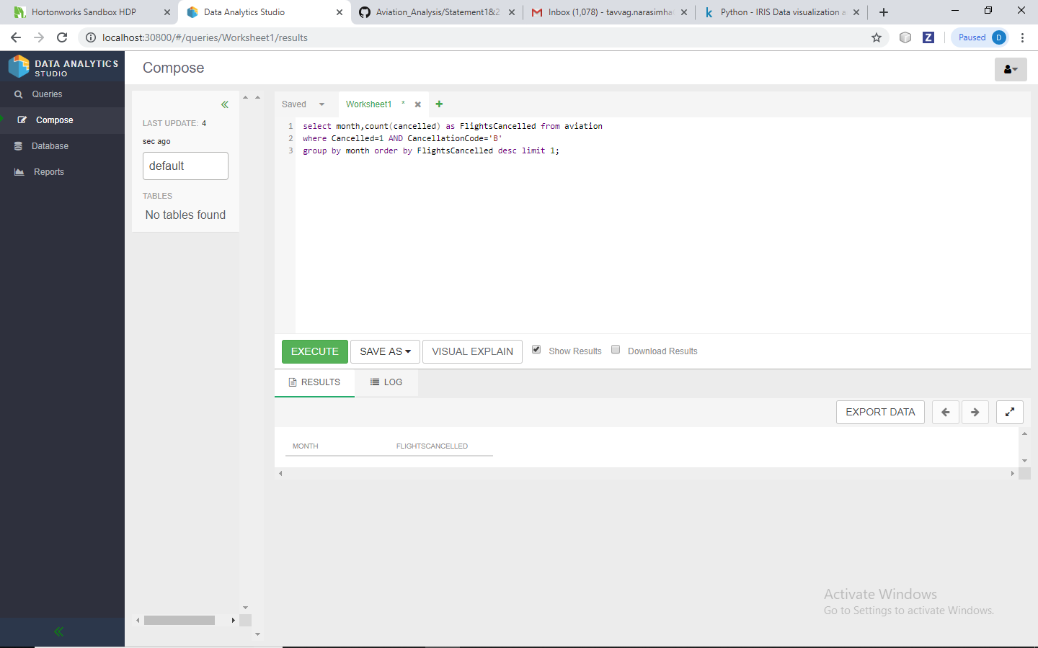

Slide 32
Problem Statement -1 Using PIG
Q1. Top 5 visited destination.
A = load '/user/tmp/DelayedFlights.csv' USING org.apache.pig.piggybank.storage.CSVExcelStorage(',','NO_MULTILINE','UNIX','SKIP_INPUT_HEADER');
B = foreach A generate (int)$1 as year, (int)$10 as flight_num, (chararray)$17 as origin,(chararray) $18 as dest;
C = filter B by dest is not null;
D = group C by dest;
E = foreach D generate group, COUNT(C.dest);
F = order E by $1 DESC;
Result = LIMIT F 5;

Slide 33
Problem Statement -2
Q2 Which month has the most number of cancellations due to bad weather?
A = load '/user/tmp/DelayedFlights.csv' USING org.apache.pig.piggybank.storage.CSVExcelStorage(',','NO_MULTILINE','UNIX','SKIP_INPUT_HEADER');
B = foreach A generate (int)$2 as month,(int)$10 as flight_num,(int)$22 as cancelled,(chararray)$23 as cancel_code;
C = filter B by cancelled == 1 AND cancel_code =='B';
D = group C by month;
E = foreach D generate group, COUNT(C.cancelled);
F= order E by $1 DESC;
Result = limit F 1;
dump Result;

Slide 34
Problem Statement -3
Q3 Top ten origins with the highest Average departure delay
A = load '/user/tmp/DelayedFlights.csv' USING org.apache.pig.piggybank.storage.CSVExcelStorage(',','NO_MULTILINE','UNIX','SKIP_INPUT_HEADER');
B1 = foreach A generate (int)$16 as dep_delay, (chararray)$17 as origin;
C1 = filter B1 by (dep_delay is not null) AND (origin is not null);
D1 = group C1 by origin;
E1 = foreach D1 generate group, AVG(C1.dep_delay);
Result = order E1 by $1 DESC;
Top_ten = limit Result 10;
Lookup = load '/user/tmp/DelayedFlights.csv' USING org.apache.pig.piggybank.storage.CSVExcelStorage(',','NO_MULTILINE','UNIX','SKIP_INPUT_HEADER');
Lookup1 = foreach Lookup generate (chararray)$0 as origin, (chararray)$2 as city, (chararray)$4 as country;
Joined = join Lookup1 by origin, Top_ten by $0;
Final = foreach Joined generate $0,$1,$2,$4;
Final_Result = ORDER Final by $3 DESC;
dump Final_Result;

Slide 35
Problem Statement -4
Q4 Which route (origin & destination) has seen the maximum diversion?
A = load '/user/tmp/DelayedFlights.csv' USING org.apache.pig.piggybank.storage.CSVExcelStorage(',','NO_MULTILINE','UNIX','SKIP_INPUT_HEADER');
B = FOREACH A GENERATE (chararray)$17 as origin, (chararray)$18 as dest, (int)$24 as diversion;
C = FILTER B BY (origin is not null) AND (dest is not null) AND (diversion == 1);
D = GROUP C by (origin,dest);
E = FOREACH D generate group, COUNT(C.diversion);
F = ORDER E BY $1 DESC;
Result = limit F 10;
dump Result;
Outputs of these 4 questions are same as the outputs of hive

Slide 36
Performance Analysis
SNO PIG HIVE
Q1 89.212 57.403
Q2 112.343 67.454
Q3 115.673 64.143
Q4 112.935 63.343

Slide 37
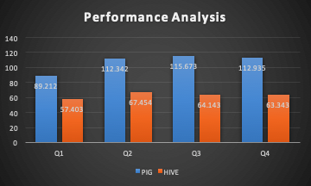
Performance Analysis

Slide 38
Performance Analysis
Hive is faster than Pig, We performed the same queries with both hive and pig. We found Hive is almost 2 -3 faster than pig in the same environment ( Same number of nodes, same data, same operation of count, same settings).
From the comparative study, the performance of the Hive is found to be more effective and time efficient for data processing as compared to Pig for the same dataset.

Slide 39
Challenges Faced
Loading Data
Analysing Data
Cleaning Data
VirtualBox Usage

Slide 40
Conclusion
Problem Statements using Hive
Problem Statements using Pig
Data Understanding using R
Performance analysis for PIG and HIVE
Spring application for usage of tools

Slide 41
THANK YOU

